Slide 1
“We women, if we are to be good women…, are not fitted to reign”: Female Literary Archetypes Represented Through Victorian Fashion
Jessie Vislay
SMP Spring 2019

Slide 2
Introduction
Five Victorian novels (1837-1901)
Study of costume
Victorian beauty ideals
Literary critique of archetypes
“Doubling”
Comparison
Complicate set archetypes

Slide 3
Chapter 1- Wuthering Heights 1847
“Hysterical Woman”
Victorian Madwoman
“Womb disease”
Confinement
Catherine Earnshaw Linton
Headstrong character
Victorian female domesticity
Edgar (Grange) vs. Heathcliff (Heights)

Slide 4
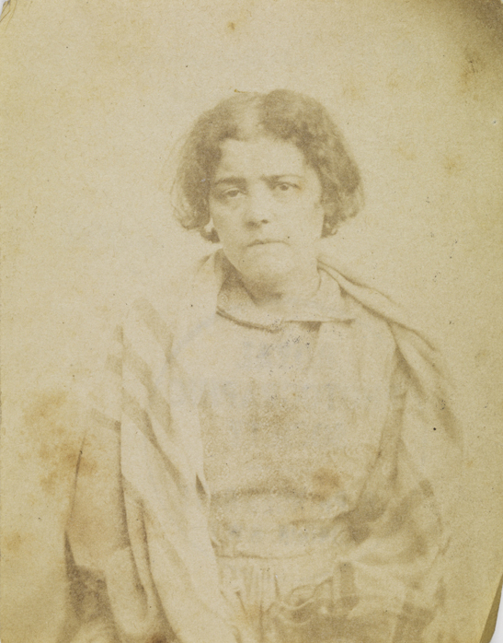
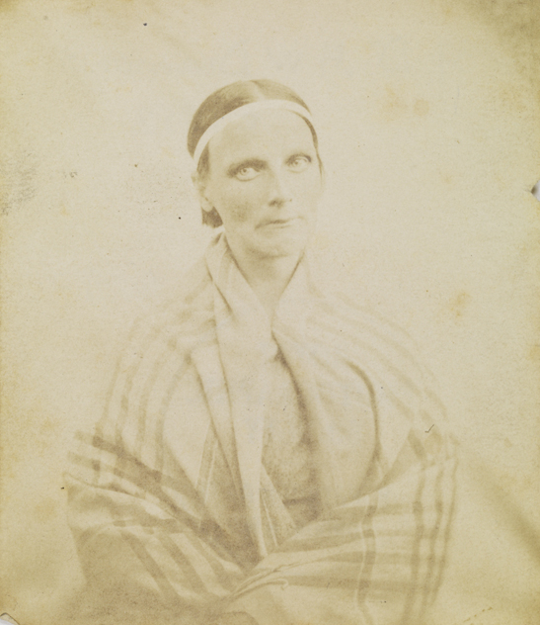
Wuthering Heights and Clothing
Madwoman
White and thin garments
Hair long and loose
Ghostly Gothic

Slide 5
Chapter 2- Jane Eyre 1847
Angel/Demon Dichotomy
Jane as angel
Spiritual
Domestic wife
Feminine and modest dress
Bertha as demon
Mixed race
Clothing and body
Animalistic sexuality

Slide 6
Chapter 2- Jane Eyre Complicated
Jane complicates “angel”
Idolizes Rochester
Fiery speech
Freedom in nature, over domesticity
Un-Victorian

Slide 7
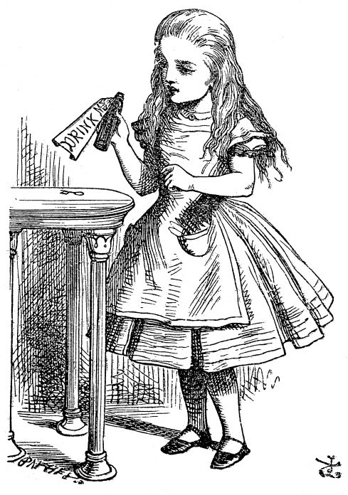
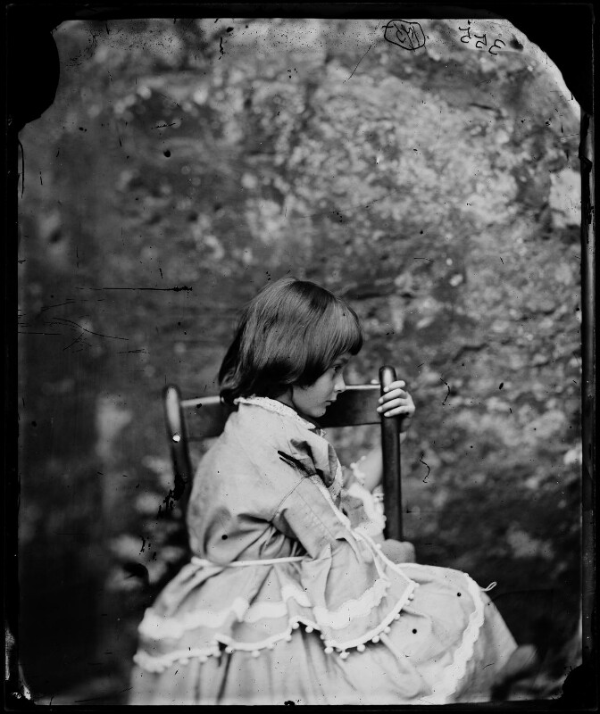
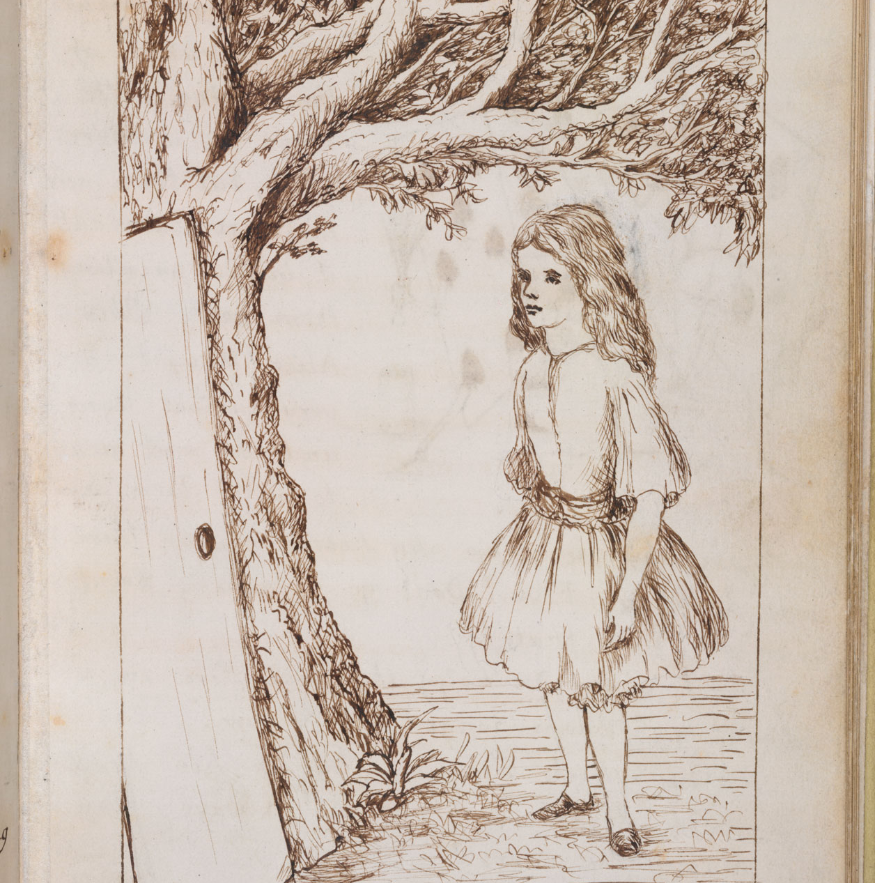
Chapter 3- Alice’s Adventures in Wonderland 1865
Three sets of pictures
Dodgson’s idyllic Alice
Carroll’s independent Alice with agency
Tenniel’s Victorian woman-in-training

Slide 8
Chapter 4- Daniel Deronda 1876
Gwendolen as “marriageable girl”
Upper-class “marriage market”
Marriage as bondage
Marriage to Mr. Grandcourt
Archetype of “wife”
Mirah
Middle-class “Jewess”
“Angel of the House”

Slide 9
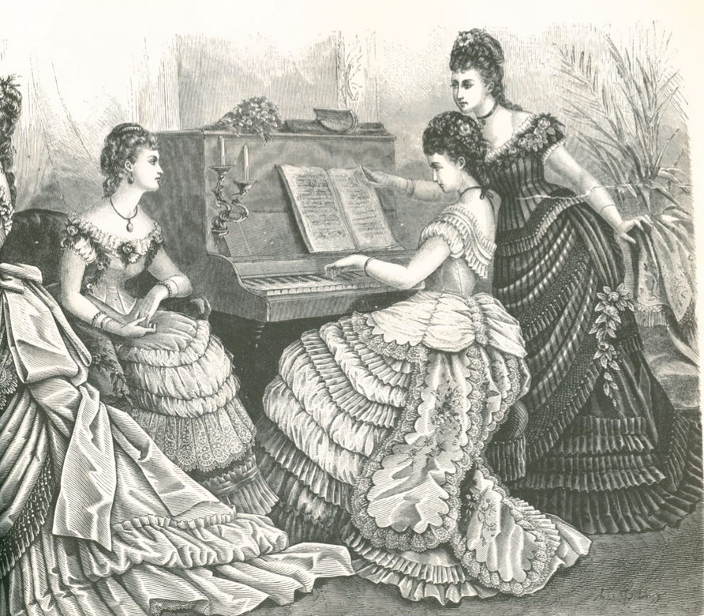
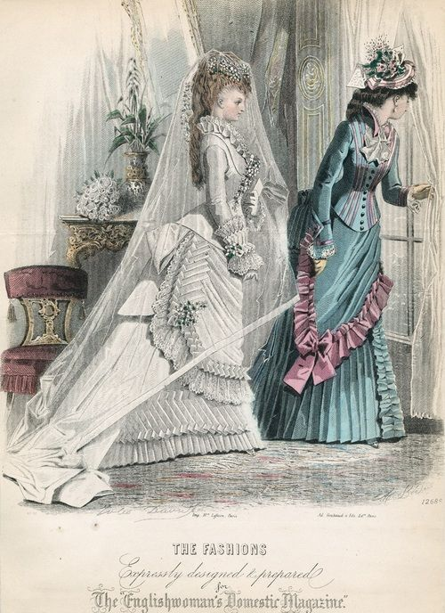
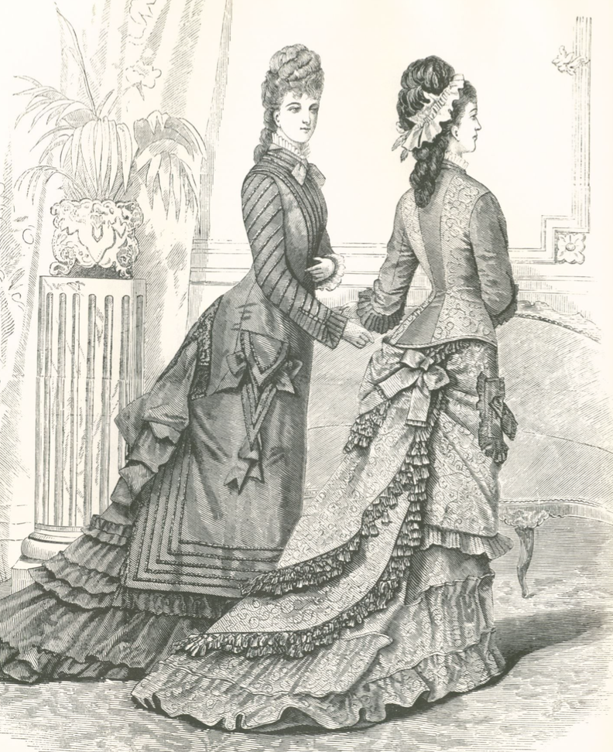
Daniel Deronda and Clothing
Upper-class clothing
Wife as display of wealth
Fitted, draped clothing
White wedding dress

Slide 10
Chapter 5- Dracula 1897
Madonna/Whore dichotomy
Mina as ideal wife and mother
Angelic, religious
“A woman’s heart and a man’s brain”
Lucy as “whore”
Fallen woman
Vampire Lucy as “whore”
Redeemed

Slide 11
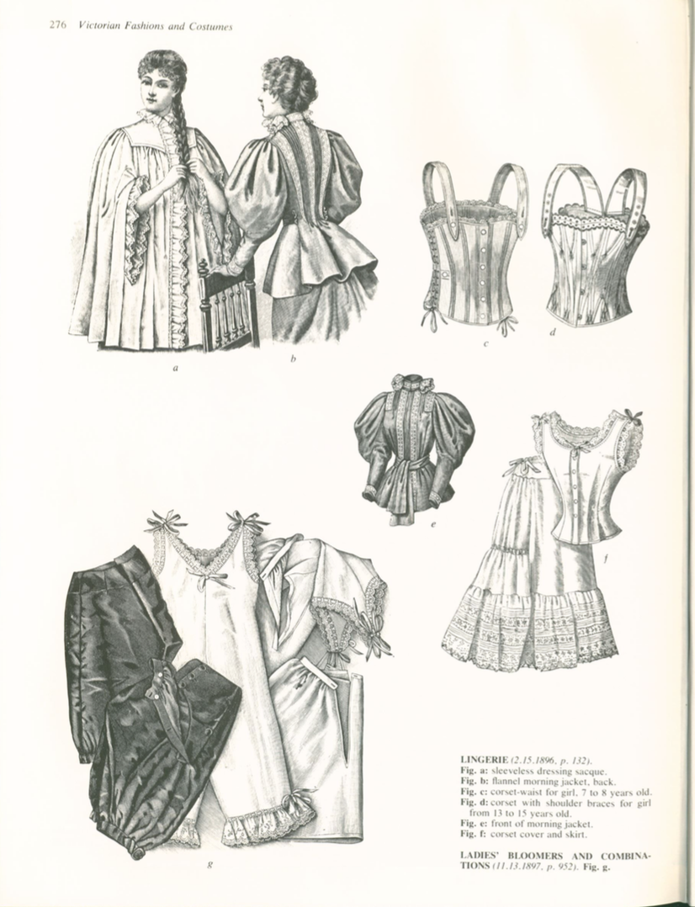
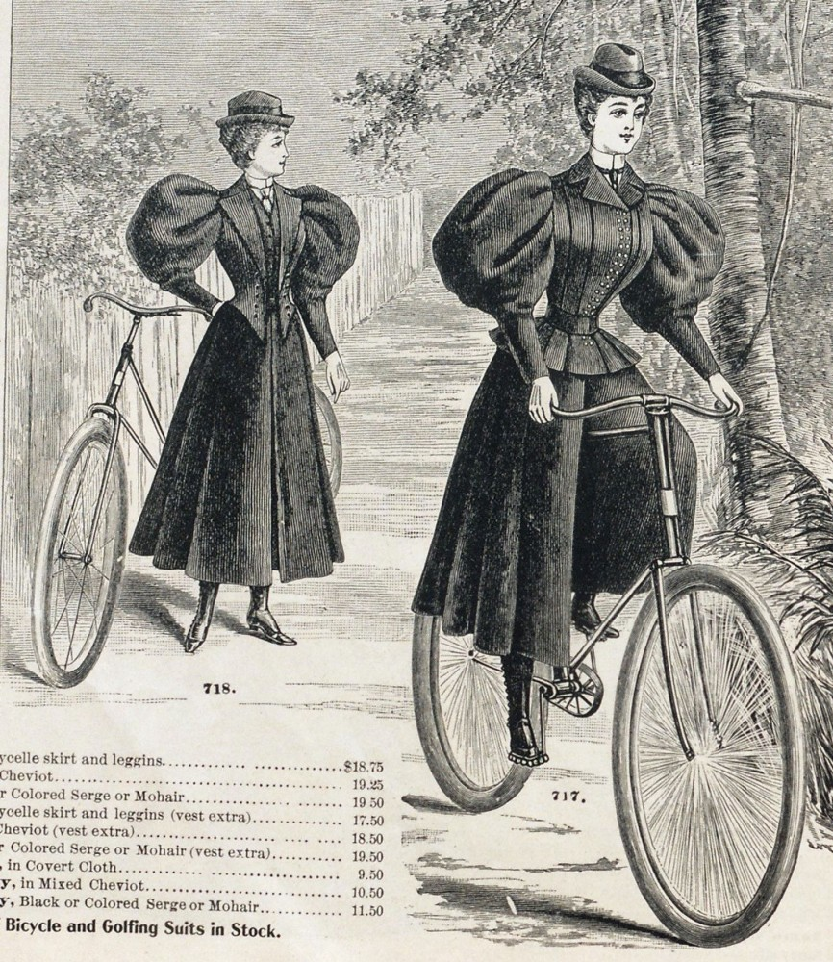
Conclusion
The New Woman
Upset traditional gender roles
Women leaving domestic sphere
Clothing reform
Undergarments
Physical activity

